Slide 1
Convolutional Neural Networks (CNN)

Slide 2
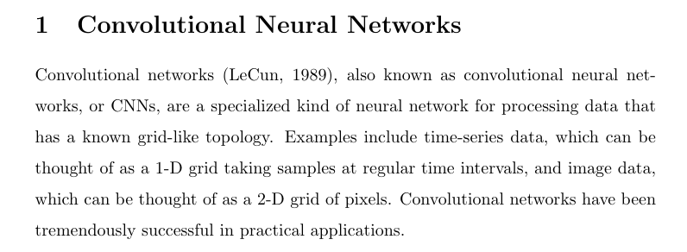
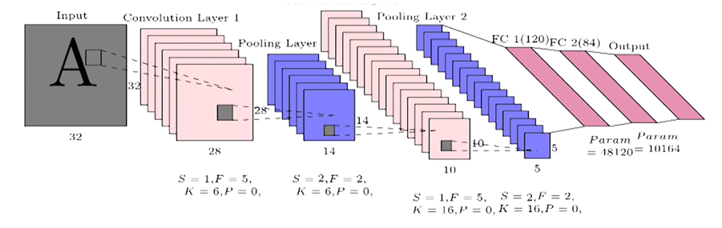

Slide 3
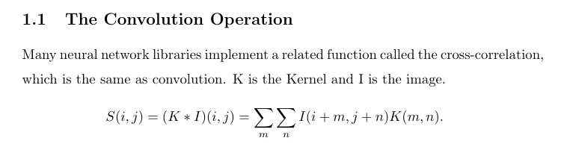
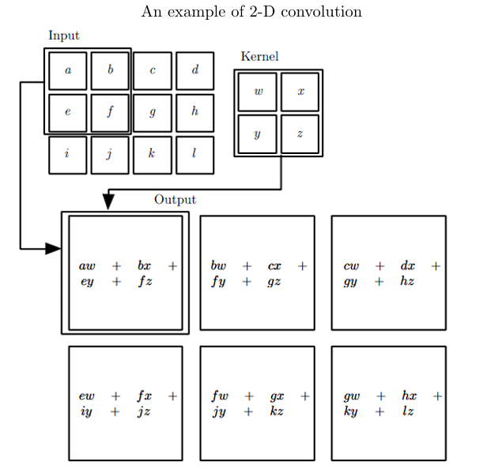

Slide 4
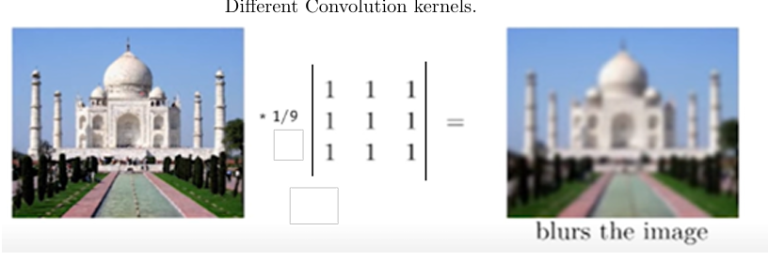

Slide 5
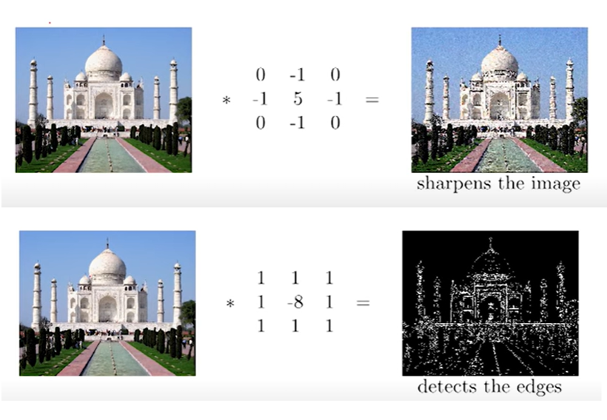

Slide 6
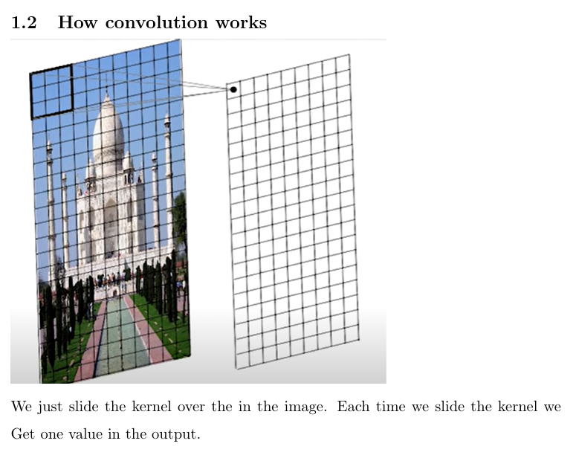

Slide 7
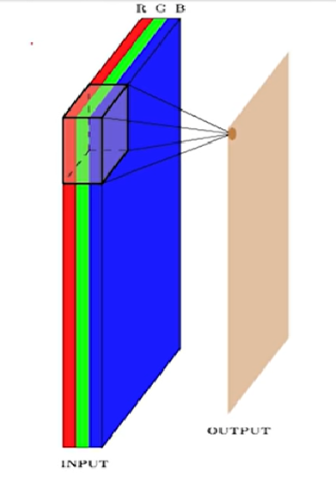
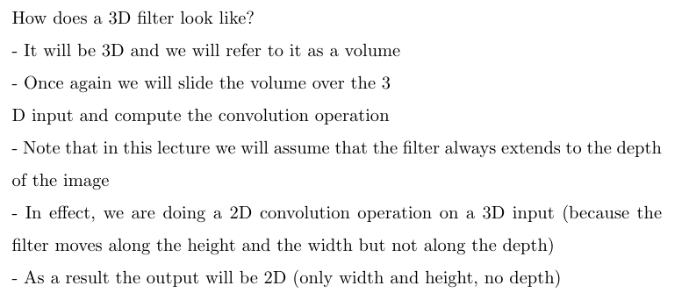

Slide 8
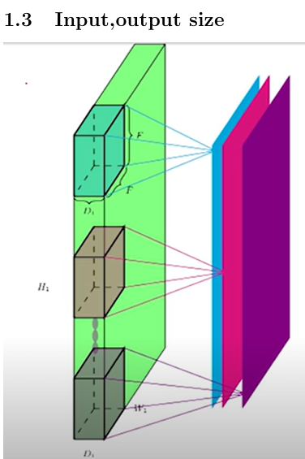
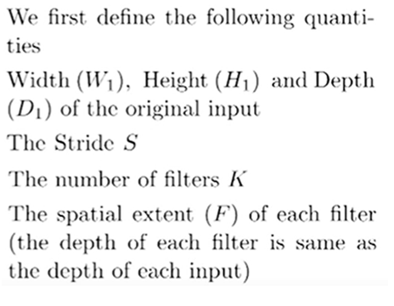

Slide 9
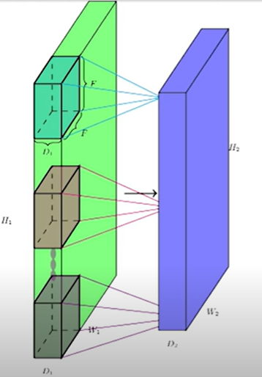
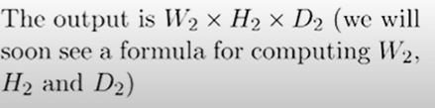

Slide 10
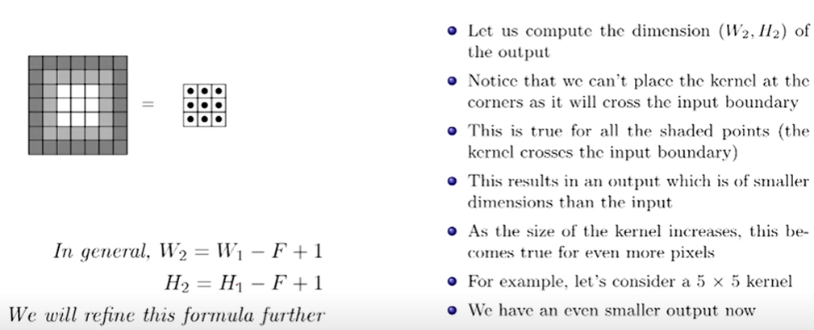

Slide 11
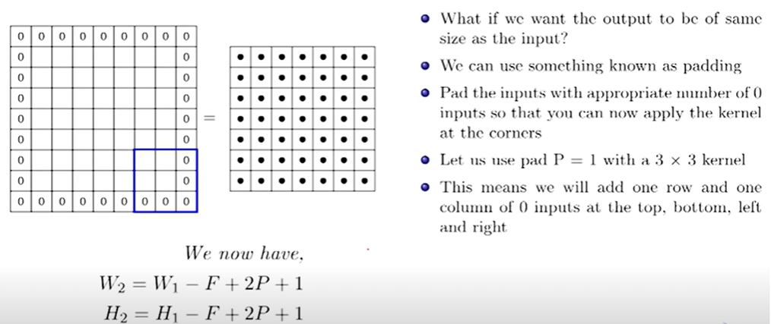

Slide 12
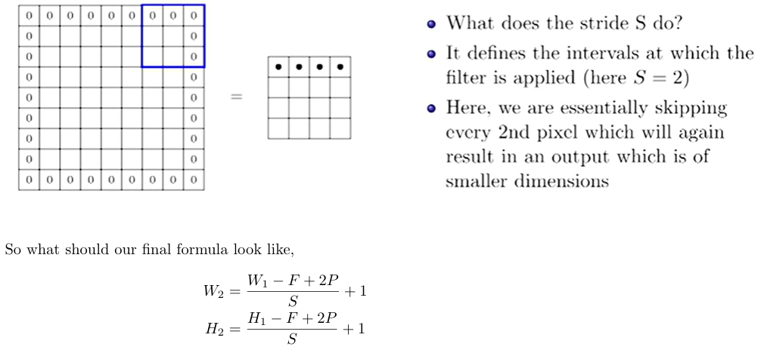

Slide 13
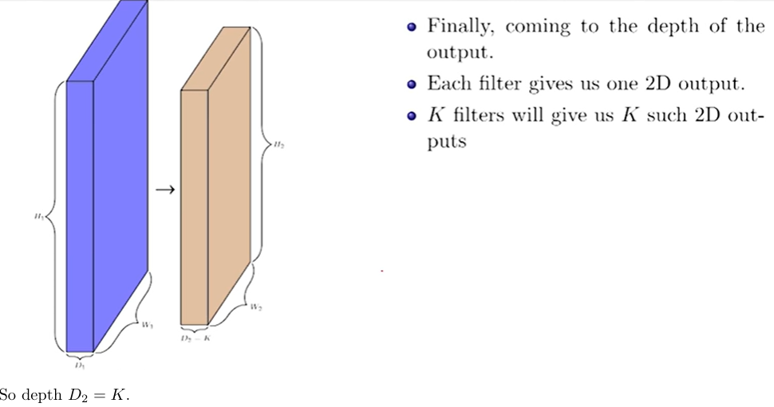

Slide 14
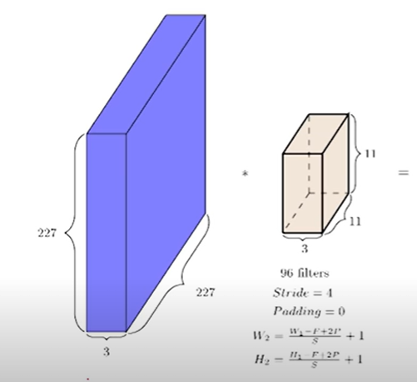

Slide 15
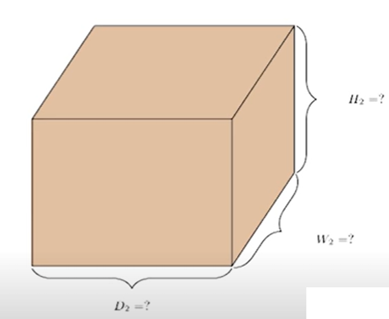

Slide 16
D2 =96,W2 =H2 =55

Slide 17
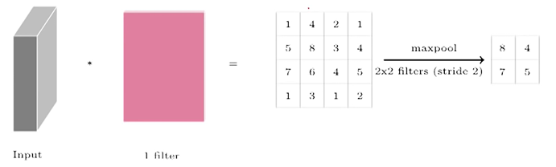
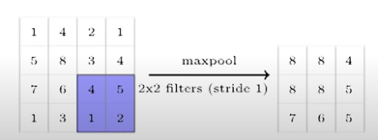
What is pooling? A pooling function replaces the output of the net at a certain location with a summary statistic of the nearby outputs. Max pooling, Average pooling
deeplizard - Max Pooling Demo

Slide 18
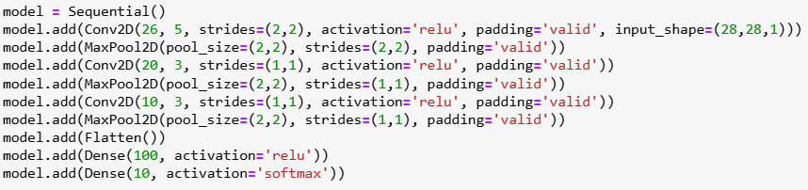
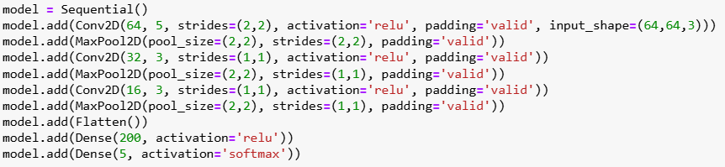

Slide 19
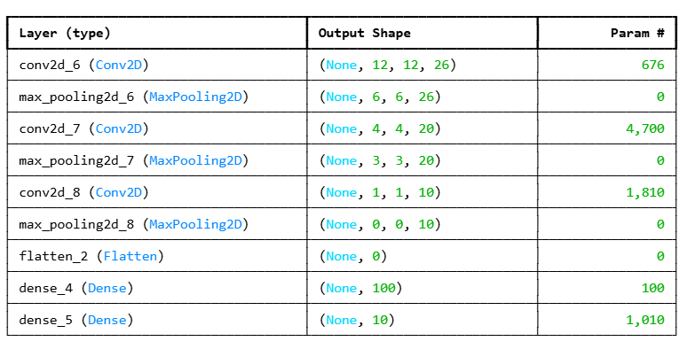
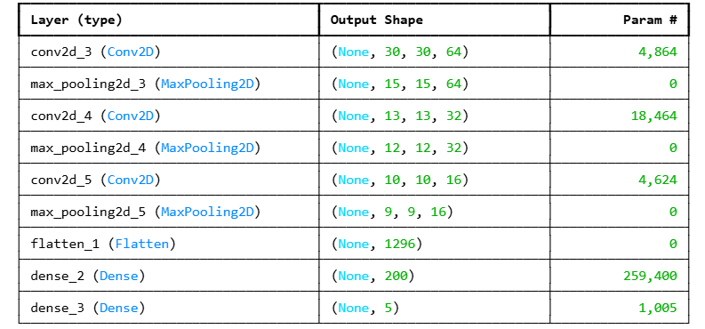

Slide 20
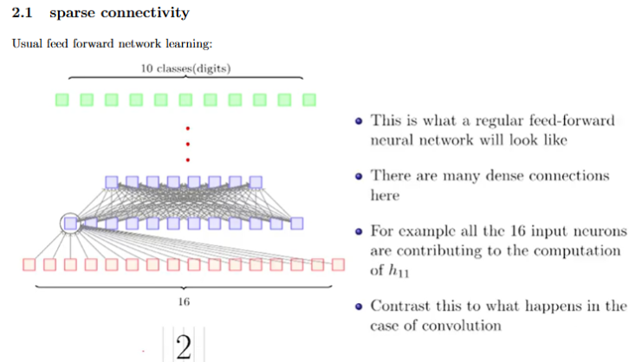
Convolution leverages two important ideas that can help improve a machine learn-ing system: sparse interactions or sparse connectivity, parameter sharing or weightsharing.

Slide 21
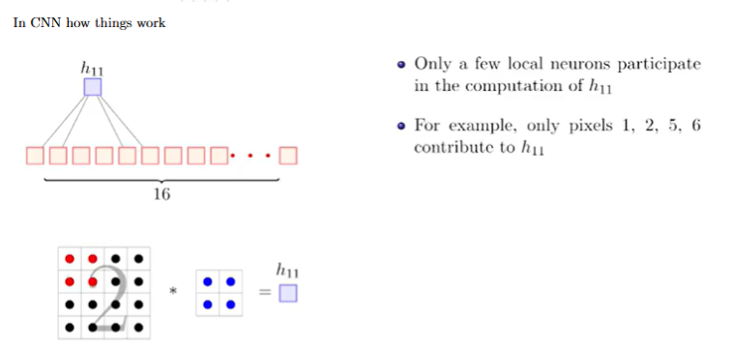

Slide 22
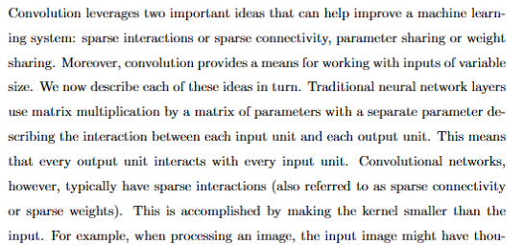

Slide 23
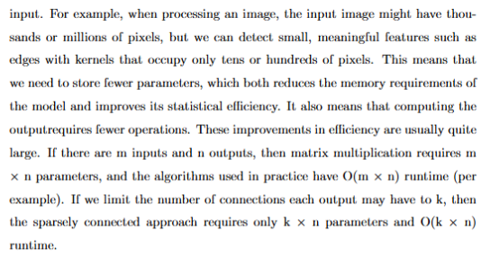

Slide 24
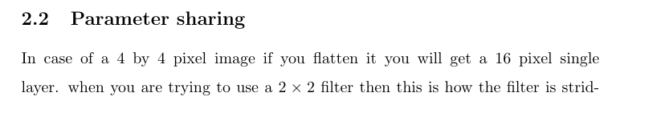
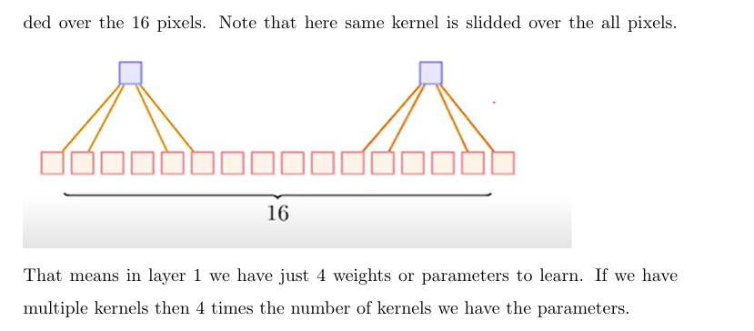

Slide 25
The property that small transformations of the input (e.g., translation, rotation, scaling) do not change the output much is called invariance a property of neural networks.
CNNs are designed to be translation invariant, mainly due to:
Weight sharing in convolution: the same filter scans across the input, so the detector fires regardless of location.
Pooling layers: aggregate local regions, making features less sensitive to small shifts.
CNNs are locally translation invariant, but not fully rotation or scale invariant.
Stability: Small changes (perturbations/noise) in the input should cause only small changes in the output.

Slide 26
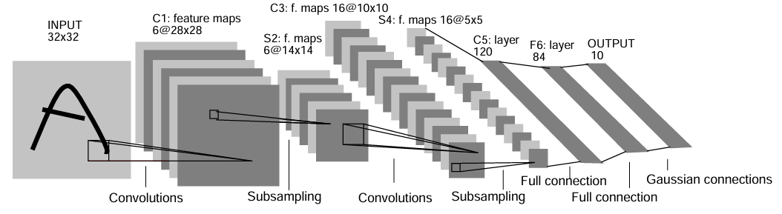
Some CNN Architectures
LeNet : LeNet is a series of convolutional neural network architectures created by a research group in AT&T Bell Laboratories during the 1988 to 1998 period, centered around Yann LeCun. They were designed for reading small grayscale images of handwritten digits and letters, and were used in ATM for reading cheques
LeNet-5 was one of the earliest convolutional neural networks and was historically important during the development of deep learning
5 kernel size
5 kernel size
Subsampling: Average pooling stride 2 with pool size (2,2)

Slide 27
AlexNet is a convolutional neural network architecture developed for image classification tasks, notably achieving prominence through its performance in the ImageNet Large Scale Visual Recognition Challenge (ILSVRC).
It classifies images into 1,000 distinct object categories and is regarded as the first widely recognized application of deep convolutional networks in large-scale visual recognition.
Layer | Kernel / Units | Stride | Padding | Output Shape
Image | – | – | – | 227×227×3
Conv1 | 11×11, 96 | 4×4 | VALID | 55×55×96
MaxPool1 | 3×3 | 2×2 | VALID | 27×27×96
Conv2 | 5×5, 256 | 1×1 | SAME | 27×27×256
MaxPool2 | 3×3 | 2×2 | VALID | 13×13×256
Conv3 | 3×3, 384 | 1×1 | SAME | 13×13×384
Conv4 | 3×3, 384 | 1×1 | SAME | 13×13×384
Conv5 | 3×3, 256 | 1×1 | SAME | 13×13×256
MaxPool3 | 3×3 | 2×2 | VALID | 6×6×256
Flatten | – | – | – | 9,216
FC1 | 4,096 units | – | – | 4,096
FC2 | 4,096 units | – | – | 4,096
FC3 | 1,000 units | – | – | 1,000
Softmax | 1,000 classes | – | – | 1,000
AlexNet architecture, which was the big breakthrough CNN that won the ImageNet Large Scale Visual Recognition Challenge (ILSVRC) 2012.

Slide 28
The VGGNets are a series of convolutional neural networks (CNNs) developed by the Visual Geometry Group (VGG) at the University of Oxford.
2014: The key architectural principle of VGG models is the consistent use of small 3 × 3 convolutional filters throughout the network. This contrasts with earlier CNN architectures that employed larger filters, such as 11 × 11 in AlexNet.
The original publication showed that deep and narrow CNN significantly outperform their shallow and wide counterparts
Name | Number of convolutional layers | Number of fully connected layers | Parameter count
VGG-16 | 13 | 3 | 138M
VGG-19 | 16 | 3 | 144M

Slide 29
Block | Layer | Kernel / Units | Stride | Padding | Output Shape
Input | Image | – | – | – | 224×224×3
Block 1 | Conv1_1 | 3×3, 64 | 1×1 | SAME | 224×224×64
 | Conv1_2 | 3×3, 64 | 1×1 | SAME | 224×224×64
 | MaxPool1 | 2×2 | 2×2 | VALID | 112×112×64
Block 2 | Conv2_1 | 3×3, 128 | 1×1 | SAME | 112×112×128
 | Conv2_2 | 3×3, 128 | 1×1 | SAME | 112×112×128
 | MaxPool2 | 2×2 | 2×2 | VALID | 56×56×128
Block 3 | Conv3_1 | 3×3, 256 | 1×1 | SAME | 56×56×256
 | Conv3_2 | 3×3, 256 | 1×1 | SAME | 56×56×256
 | Conv3_3 | 3×3, 256 | 1×1 | SAME | 56×56×256
 | MaxPool3 | 2×2 | 2×2 | VALID | 28×28×256
Block 4 | Conv4_1 | 3×3, 512 | 1×1 | SAME | 28×28×512
 | Conv4_2 | 3×3, 512 | 1×1 | SAME | 28×28×512
 | Conv4_3 | 3×3, 512 | 1×1 | SAME | 28×28×512
 | MaxPool4 | 2×2 | 2×2 | VALID | 14×14×512
Block 5 | Conv5_1 | 3×3, 512 | 1×1 | SAME | 14×14×512
 | Conv5_2 | 3×3, 512 | 1×1 | SAME | 14×14×512
 | Conv5_3 | 3×3, 512 | 1×1 | SAME | 14×14×512
 | MaxPool5 | 2×2 | 2×2 | VALID | 7×7×512
FC Layers | Flatten |  |  |  | 25,088
 | FC1 | 4096 units |  |  | 4096
 | FC2 | 4096 units |  |  | 4096
 | FC3 | 1000 units |  |  | 1000
Output | Softmax | 1000 classes |  |  | 1000
VGG 16

Slide 30
Block | Layer | Kernel / Units | Stride | Padding | Output Shape
Input | Image | – | – | – | 224×224×3
Block 1 | Conv1_1 | 3×3, 64 | 1×1 | SAME | 224×224×64
 | Conv1_2 | 3×3, 64 | 1×1 | SAME | 224×224×64
 | MaxPool1 | 2×2 | 2×2 | VALID | 112×112×64
Block 2 | Conv2_1 | 3×3, 128 | 1×1 | SAME | 112×112×128
 | Conv2_2 | 3×3, 128 | 1×1 | SAME | 112×112×128
 | MaxPool2 | 2×2 | 2×2 | VALID | 56×56×128
Block 3 | Conv3_1 | 3×3, 256 | 1×1 | SAME | 56×56×256
 | Conv3_2 | 3×3, 256 | 1×1 | SAME | 56×56×256
 | Conv3_3 | 3×3, 256 | 1×1 | SAME | 56×56×256
 | Conv3_4 | 3×3, 256 | 1×1 | SAME | 56×56×256
 | MaxPool3 | 2×2 | 2×2 | VALID | 28×28×256
Block 4 | Conv4_1 | 3×3, 512 | 1×1 | SAME | 28×28×512
 | Conv4_2 | 3×3, 512 | 1×1 | SAME | 28×28×512
 | Conv4_3 | 3×3, 512 | 1×1 | SAME | 28×28×512
 | Conv4_4 | 3×3, 512 | 1×1 | SAME | 28×28×512
 | MaxPool4 | 2×2 | 2×2 | VALID | 14×14×512
Block 5 | Conv5_1 | 3×3, 512 | 1×1 | SAME | 14×14×512
 | Conv5_2 | 3×3, 512 | 1×1 | SAME | 14×14×512
 | Conv5_3 | 3×3, 512 | 1×1 | SAME | 14×14×512
 | Conv5_4 | 3×3, 512 | 1×1 | SAME | 14×14×512
 | MaxPool5 | 2×2 | 2×2 | VALID | 7×7×512
FC Layers | Flatten | – | – | – | 25,088
 | FC1 | 4096 units | – | – | 4096
 | FC2 | 4096 units | – | – | 4096
 | FC3 | 1000 units | – | – | 1000
Output | Softmax | 1000 classes | – | – | 1000
VGG 19

Slide 31
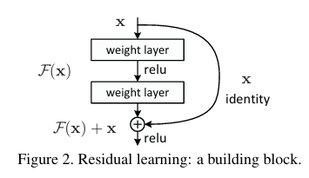
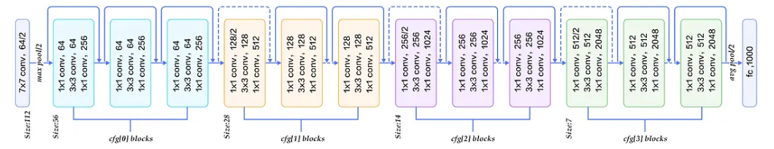
ResNet stands for Residual Network.
Introduced by Microsoft in 2015 (He et al.) in the paper "Deep Residual Learning for Image Recognition".
Won the ImageNet 2015 competition because it solved a big problem in deep learning: degradation with very deep networks.

Slide 32
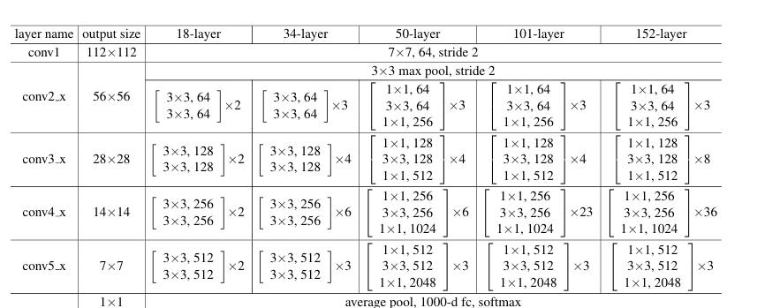

Slide 33
Other models you can refer: GoogleNet, DenseNet, MobileNet, EfficientNet, Vi Transformer

Slide 34
Global Average pooling
Average all values in each feature map. Used in Google Net, ResNet etc.
If feature map = 7×7×512, GAP → 1×1×512 vector
Global Max pooling
Maximum of all values in each feature map
If feature map = 7×7×512, GAP → 1×1×512 vector

Slide 35
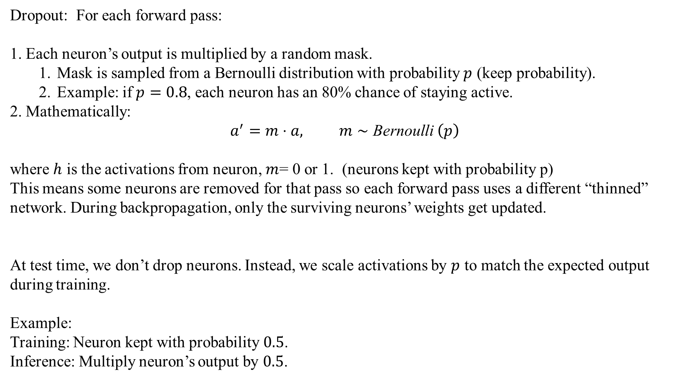
Dropout, Drop-connect, and Batch Normalization
Dropout: For each forward pass:
Each neuron’s output is multiplied by a random mask.
Mask is sampled from a Bernoulli distribution with probability $p$ (keep probability).
Example: if $p=0.8$, each neuron has an 80% chance of staying active.
Mathematically:
$$a^{′}=m⋅a, m∼\text{Bernoulli} \left(p\right)$$
where $h$ is the activations from neuron, $m$= 0 or 1. (neurons kept with probability p)
This means some neurons are removed for that pass so each forward pass uses a different “thinned” network. During backpropagation, only the surviving neurons’ weights get updated.
At test time, we don’t drop neurons. Instead, we scale activations by $p$ to match the expected output during training.
Example:
Training: Neuron kept with probability $0.5$.
Inference: Multiply neuron’s output by $0.5$.

Slide 36
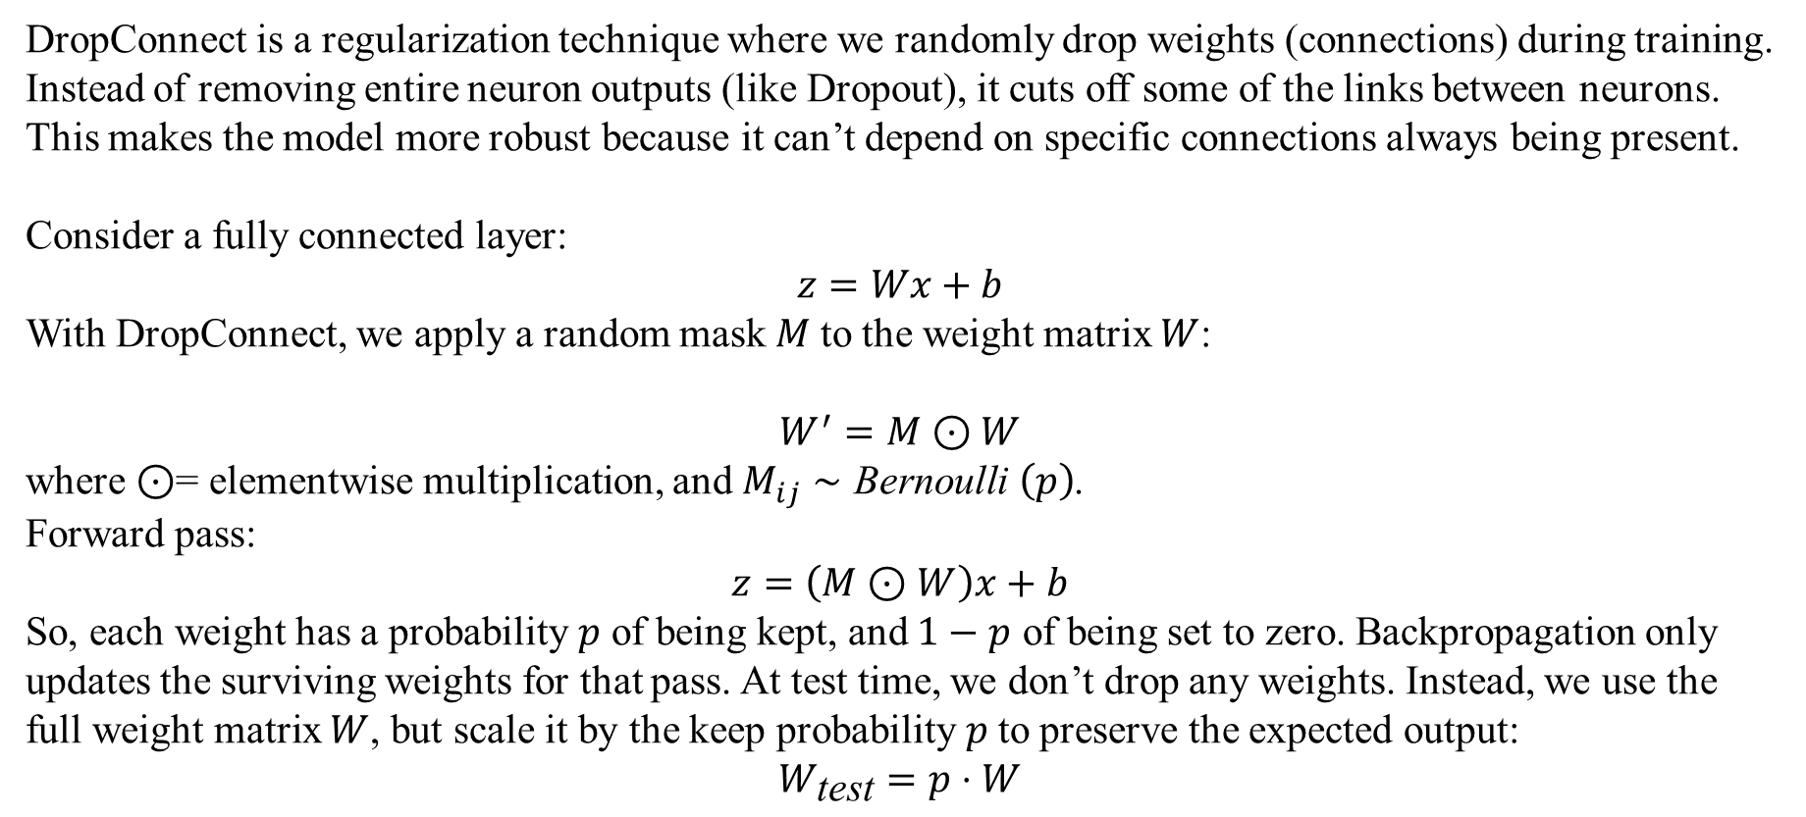
Dropout, Drop-connect, and Batch Normalization
Drop-connect: Li wan et al. 2013.
DropConnect is a regularization technique where we randomly drop weights (connections) during training. Instead of removing entire neuron outputs (like Dropout), it cuts off some of the links between neurons. This makes the model more robust because it can’t depend on specific connections always being present.
Consider a fully connected layer:
$$z=Wx+b$$
With DropConnect, we apply a random mask $M$to the weight matrix $W$:
$$W^{′}=M⊙W$$
where $⊙$= elementwise multiplication, and $M_{ij}∼\text{Bernoulli} \left(p\right)$.
Forward pass:
$$z=\left(M⊙W\right)x+b$$
So, each weight has a probability $p$ of being kept, and $1−p$ of being set to zero. Backpropagation only updates the surviving weights for that pass. At test time, we don’t drop any weights. Instead, we use the full weight matrix $W$, but scale it by the keep probability $p$to preserve the expected output:
$$W_{\text{test}}=p⋅W$$

Slide 37
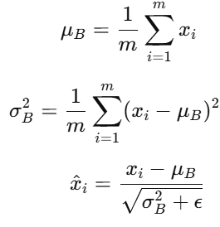

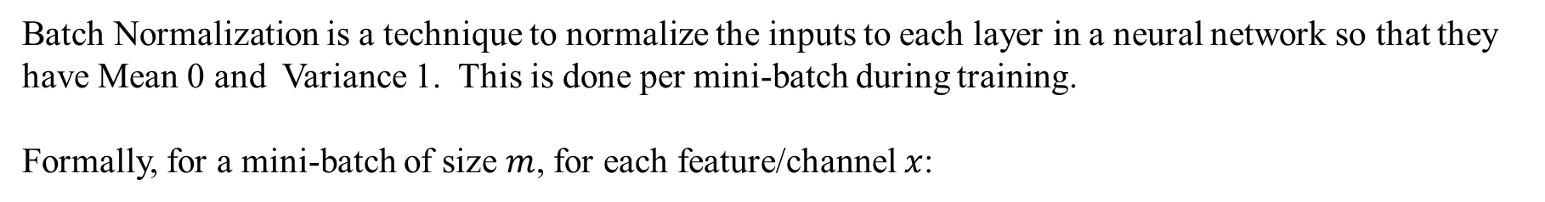
Batch Normalization
Batch Normalization is a technique to normalize the inputs to each layer in a neural network so that they have Mean 0 and Variance 1. This is done per mini-batch during training.
Formally, for a mini-batch of size $m$, for each feature/channel $x$:
Then a learnable scale and shift are applied:
γ,β are trainable parameters
ϵ is a small number to avoid division by zero

